Slide 1

ESO Enterprise Data Platform – Demand Summary FY21 March 2020

Slide 2
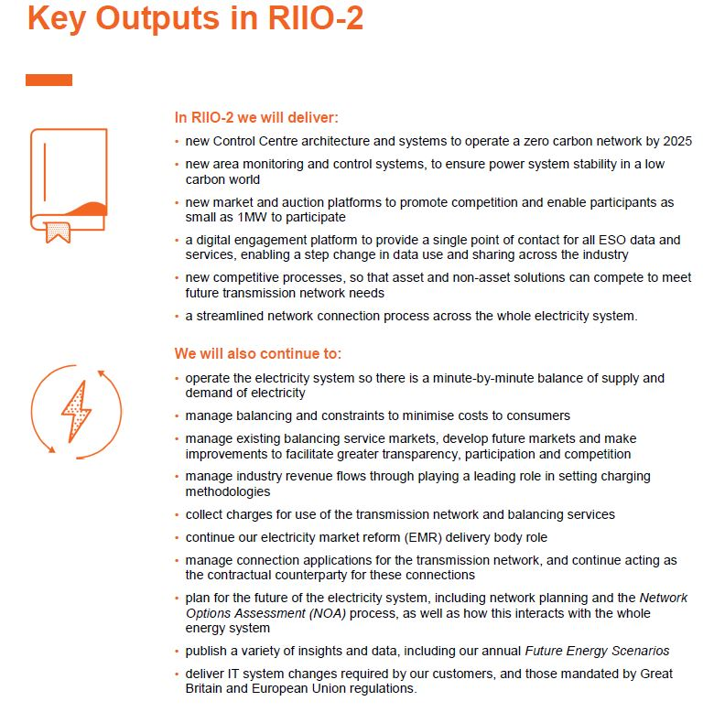

Slide 3
ESO has set out an ambitious plan for RIIO-2
Theme 1
Ensure reliable, secure system operation to deliver electricity when customers need it
Theme 2
Transforming participation in smart and sustainable markets
Theme 3
Unlock consumer value through competition
Theme 4
Driving towards a sustainable, whole energy future
Control centre, balancing and network control capabilities
Ability to operate a carbon-free system
Open data portal
Modelling and simulation (digital twin)
Training
Restoration
Close to real-time markets for balancing services
Equal access for market participants 1MW and above
Single integrated market platform
Code management and accessibility
Expanded NOA process with more connections, wider works, and end-of-life asset replacement
Targeted review of SQSS
Early competition plan proposal
Insight to inform policy
Facilitate efficient connection and access to the system
Ensure we have the tools to manage overall system operability
Scale of change (£407m IT ; £450m Business direct portfolio)
Pace of change (first deliverables in FY22)
Notes:
Technology is inseparable from our ambition
Our information technology (IT) strategy is deeply embedded within our organisational strategy
Our core systems provide secure, highly available and reliable services that support system operation and competitive open markets, and ensure the lights stay on around the clock
Our technologies must enable a market where anyone can participate, regardless of their generation type or the maturity of their in-house systems and technical capability

Slide 4
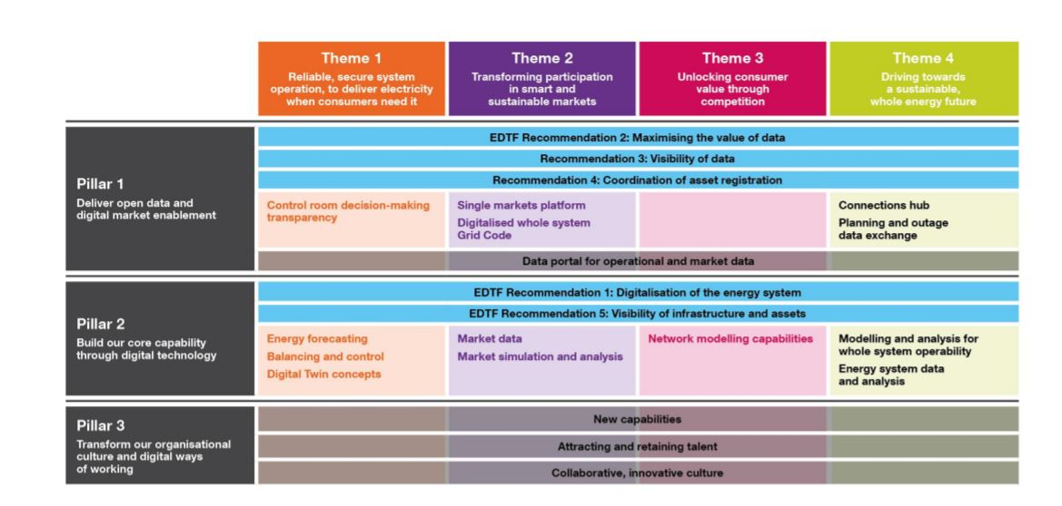
Themes – Data and Digital
EDTF – Energy Data Task Force (UK Gov; OFGEM; Energy Industry)

Slide 5
Electricity System Operator landscape
Digital experience, channels and engagement
Web sites, APIs
Native device channels
Social media, chat, alerts
Content management
Knowledge management
Workflow
Customer relationship mgt. (CRM)
Insights and data
Data management
Internal / external reporting
Digital twin
Simulation and modelling
Predictive analytics
Digital grid code
Network operation, control & development
Command and control
Outage planning
Network analysis
Energy balancing
Planning & forecasting
Scheduling
Dispatch
Commercial and markets
Ancillary services
Market enablement
Capacity markets
Training and development
Command and control, balancing, commercial and markets
Shared foundation
CNI data centres
IT Networks (LAN / WAN)
Cyber
End user computing
Shared services

Slide 6
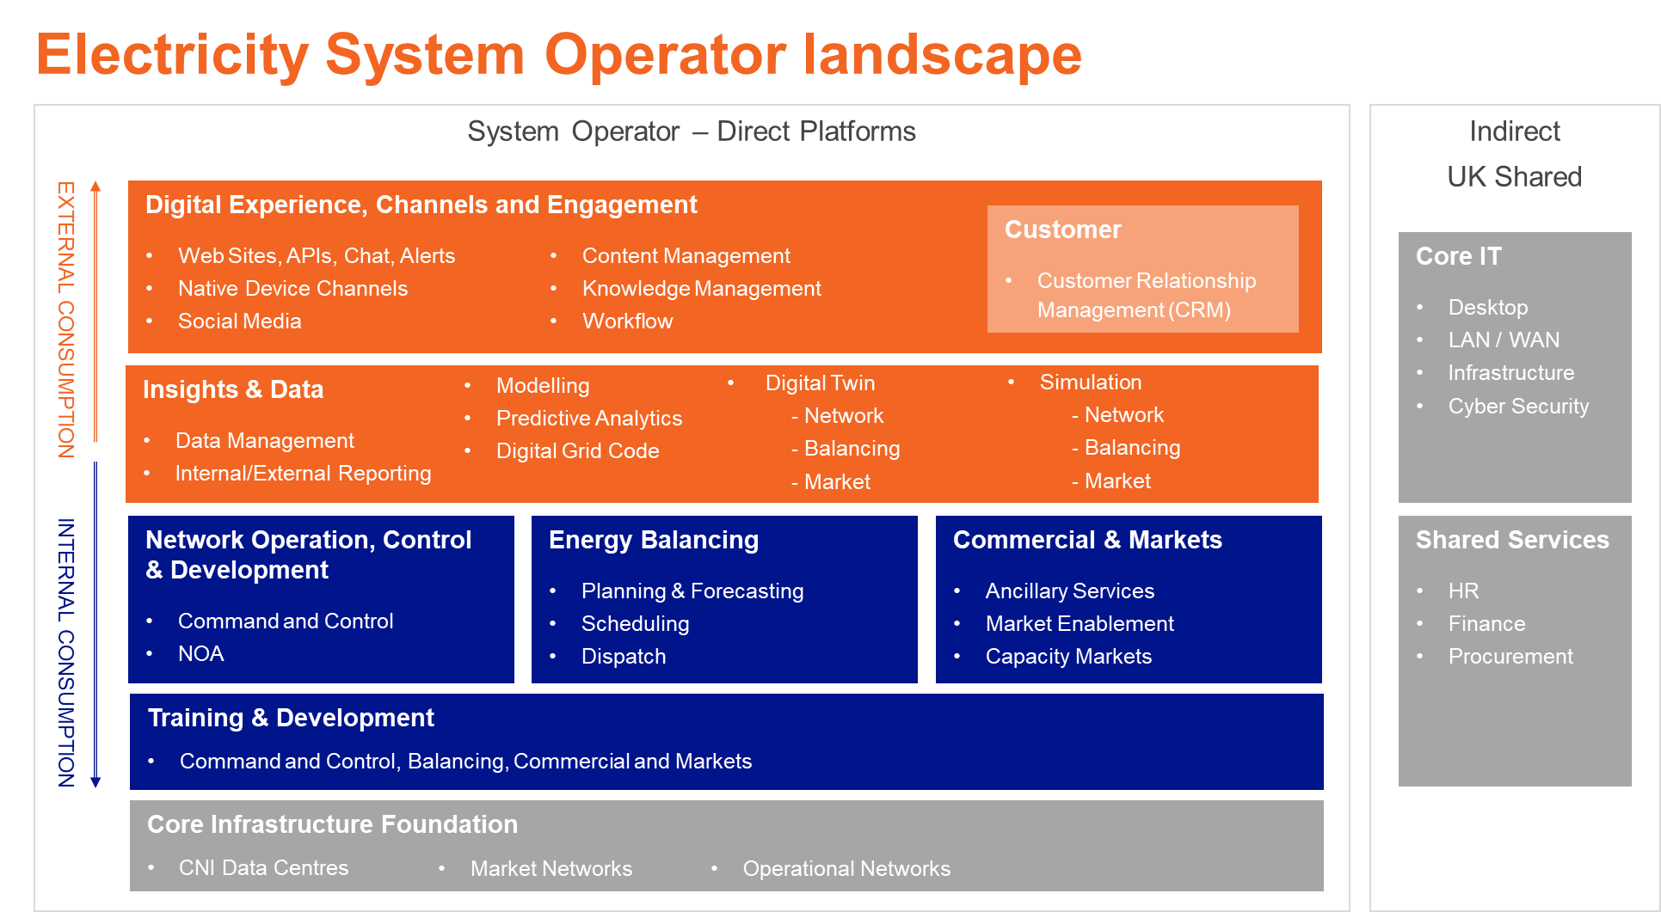
Electricity System Operator landscape
Insights & Innovation
Data Lake holding all raw and aggregated data for external and internal use
Foundation for support of new digital capabilities – AI, Simulation, Modeling
Digital Experience / Communication Platform
‘Portal’ landing area for all external engagement
Transactional customer engagement (CRM, APIs)
Information Exchange / Discussion (Blog, Debate, Social Media)
Native Device Experience (IPHONE – Android)
Alert / Chat
Training & Development
Mirror production capability using digital technologies and innovation
Certification and continuous education
Engineering & Market Platforms
Enhanced Command, Control, Balancing
Utilise Insights and Innovation
Reliability and Asset Heath
Core Infrastructure
Wider Access Networks

Slide 7
Platform architecture approach
Customers
Stakeholders
ESO teams
Vertical business capability
Example: Issuing and reporting of balancing instructions
API access to data (e.g. MW, price, duration of instruction)
Decision transparency (reason for instruction)
Digital experience, channels and engagement
Internal access to all unit parameters to send instruction and system limits in all relevant systems
Insights and data
Ability to instruct any type of service to any type of unit
Economic and secure decisions supported by AI
Engineering services
Control centre engineers have rehearsed scenarios using digital twin
Training and development
Applications hosted on critical national infrastructure
Dual-redundant, high-availability, and highly-secure
Shared infrastructure
Horizontal technology platforms

Slide 8
ESO Enterprise Data Platform – Demand Summary
1. ESO General Requirements
Diverse Data Management Workloads: Datawarehouse, Data Lake, Data Staging, Unstructured Data Management, Event Processing across ‘Historic’ , ‘Real-Time’ , and ‘Future Modelling’ data sets.
Usage by Mathematical Modelling, Mathematical Optimisation, Data Science, analytics, and Machine Learning teams in the business (i.e. not IT) – Business “Self-Service” Capability
Usage for CNI private hosted, and cloud resident workloads.
CNI , private hosted, and cloud resident data sources and targets.
Secure Partner/Customer/ Academic Access
Open Public Data Access
Cost Efficiency / Scalability for ‘Public Access’

Slide 9
ESO Enterprise Data Platform – Demand Summary
FY21 Initiatives
2. ESO Project Specific Demand Highlights
Future Balancing Programme (FBP): Mathematical Optimisation, Data Science, Machine Learning, Artificial Intelligence
Design and Development Capability Required Q2/Q3 FY21
Electricity Market Reform (EMR): Secure Partner/Customer Access, Data Warehouse, and Data Staging
Go-Live Required Q2/Q3 FY21
Revenue21-23 Charging and Billing: Data Warehouse; Data Staging ; Reporting and Analytics
Go Live Required Q3/Q4 FY21
Forward Plan Strategic Commitments: Data Staging / Report Publishing
Go Live Required Q2/Q3 FY21
Transmission Operator Generator Availability (TOGA): Data Warehouse, Data Staging, and Data Lake
Go-Live Required Q3 FY21
Platform For Energy Forecasting (PEF): Mathematical Modelling, Data Science, analytics, and Machine Learning
Go-Live Required Q3 FY21

Slide 10
Electricity System Operator landscape – 2021
Digital experience, channels and engagement
Web sites, APIs
Native device channels
Social media, chat, alerts
Key
Delivery Priority
Planning / Pipeline
Content management
Knowledge management
Workflow
Customer relationship mgt. (CRM)
Insights and data
Data management
Internal / external reporting
Digital twin
Simulation and modelling
Predictive analytics
Digital grid code
Network operation, control & development
Command and control
Outage planning
Network analysis
Energy balancing
Planning & forecasting
Scheduling
Dispatch
Commercial and markets
Ancillary services
Market enablement
Capacity markets
Training and development
Command and control, balancing, commercial and markets
Shared foundation
CNI data centres
IT Networks (LAN / WAN)
Cyber
End user computing
Shared services

